Slide 1
Preparing the Flood Elev Diff map
Sulochan Dhungel

Slide 2
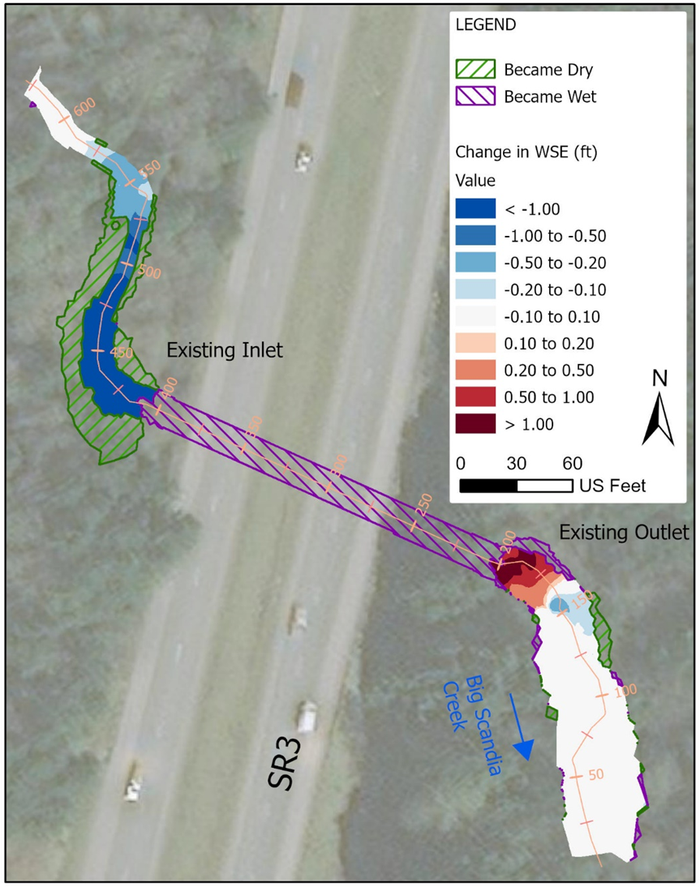
The workflow is to prepare this figure

Slide 3
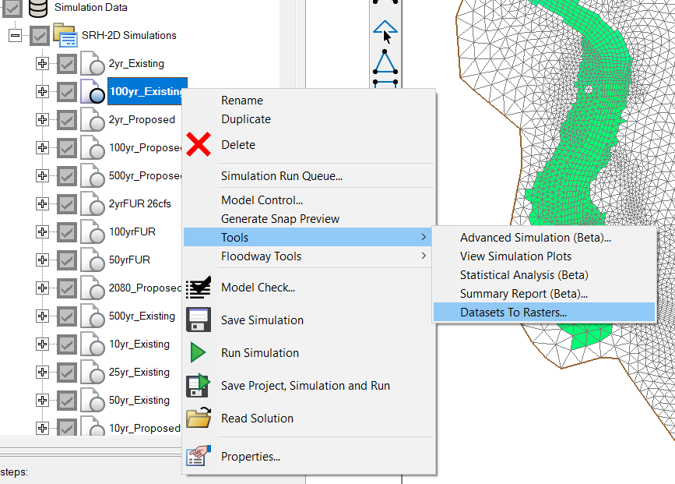
Extract data from SMS to use
In SMS, right click the simulation plan for 100-yr existing.
Go to Tools -> Datasets to Rasters..

Slide 4
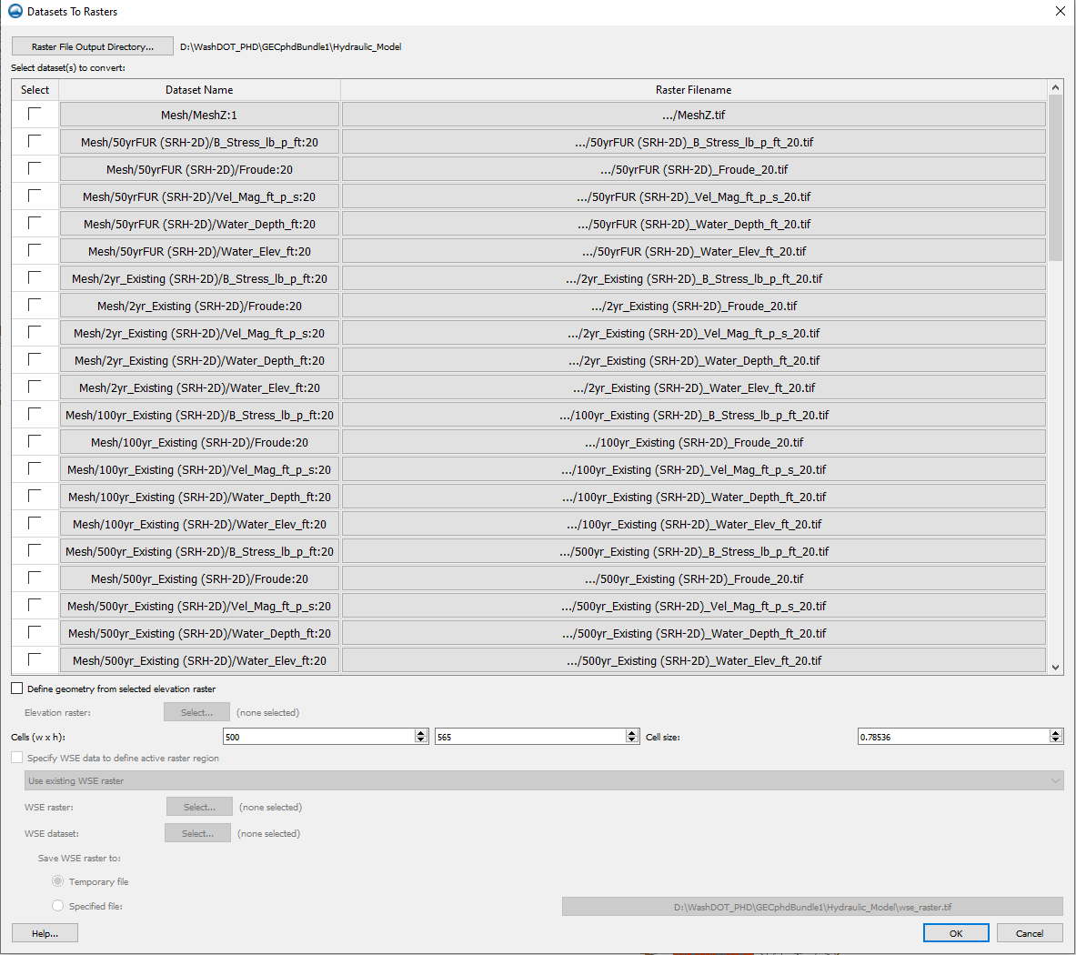
Extract data from SMS to use
In SMS, right click the simulation plan for 100-yr existing or 100-yr proposed.
Go to Tools -> Datasets to Rasters..
In the Datasets to Rasters dialog box, select the output folder by clicking on “Raster File Output Directory..”

Slide 5
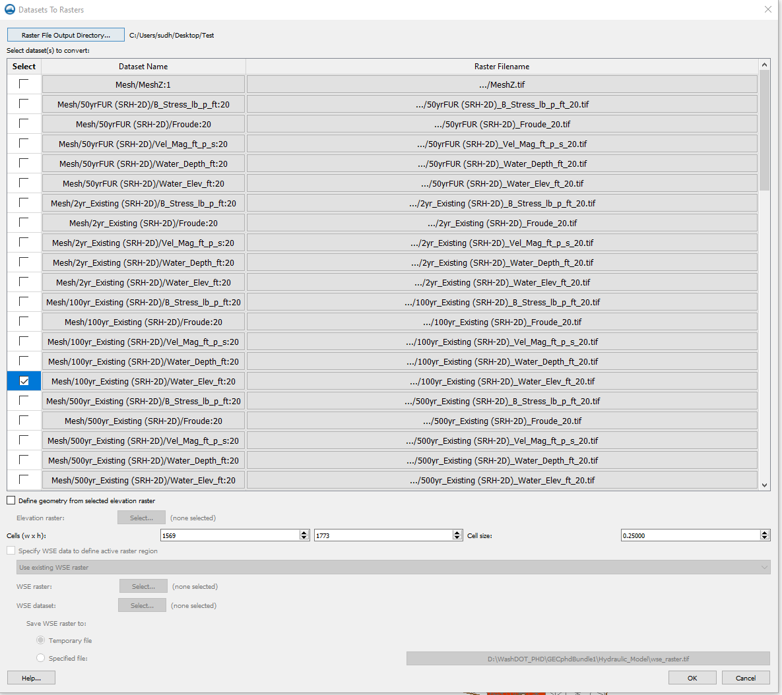
Extract data from SMS to use
Under datasets to convert -> check the raster for 100-yr existing
Change the cell size to required resolution (for my case, I chose to export it as 0.25 ft resolution)
Press OK.

Slide 6
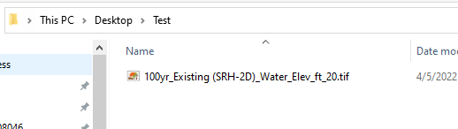
Extract data from SMS to use
Under datasets to convert -> check the raster for 100-yr existing
Change the cell size to required resolution (for my case, I chose to export it as 0.25 ft resolution)
Press OK.
The existing 100-yr elev raster is exported.

Slide 7
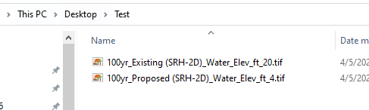
Extract data from SMS to use
Use the same method to export proposed 100-yr elevation raster

Slide 8
Using ArcGIS to prepare the data
Make sure you have the spatial analyst license

Slide 9
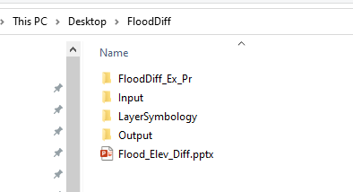
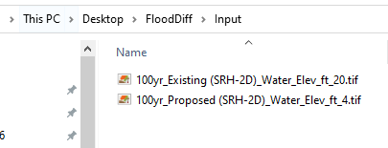
GIS workflow
Copy the folder which has FloodDiff_Ex_Pr GIS file.
Open the Input Folder and copy the two SMS exported files in this folder.

Slide 10
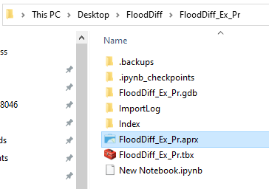
GIS workflow
Open the GIS file within the folder “FloodDiff_Ex_Pr.aprx”

Slide 11
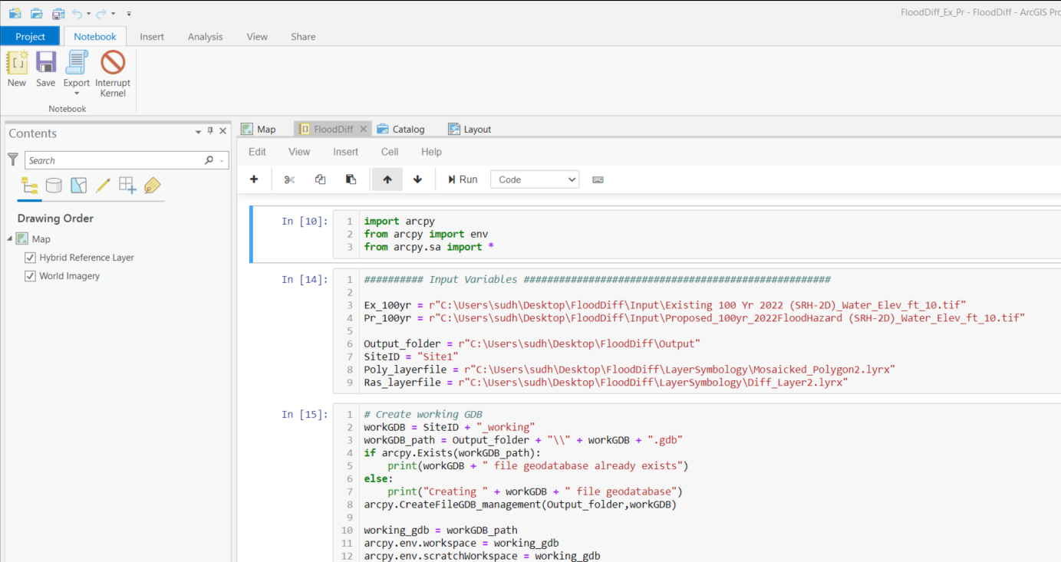
GIS workflow
Go to the “FloodDiff” Notebook.

Slide 12
GIS workflow
Under Input variables, change the path of the files.
Ex_100yr => the existing 100yr elevation raster
Pr_100yr => the proposed 100yr elevation raster
Output_folder => path to the output folder of GIS folder copied
SiteID => SiteCode
Poly_layerfile => path to the file “Mosaicked_Polygon2.lyrx” in the layer symbology folder of GIS folder copied
Ras_layerfile => path to the file “Diff_Layer2.lyrx” in the layer symbology folder of GIS folder copied

Slide 13
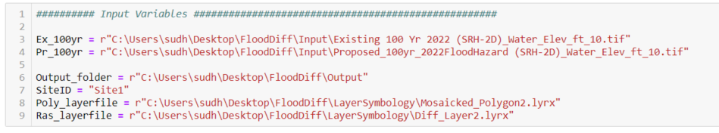
GIS workflow
I had copied the GIS folder to Desktop. So, my paths look like this:

Slide 14
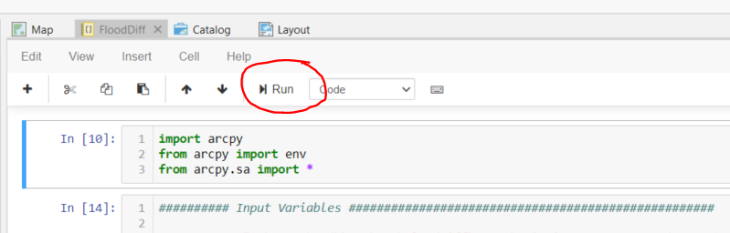
GIS workflow
Run the first cell by pressing Run button on the top. If you have access to the spatial analyst license it should run without errors.

Slide 15
GIS workflow
If you don’t have access to spatial analyst license, the other steps will not work. Get the license and continue.

Slide 16
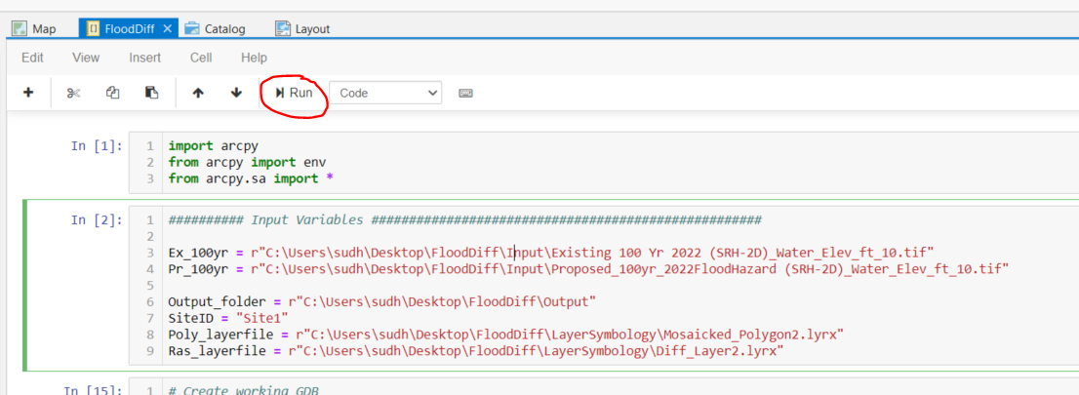
GIS workflow
Go to the second cell and Press Run. Make sure that all the paths to files are correct. This is where you would want to check if any of the following steps don’t work.

Slide 17
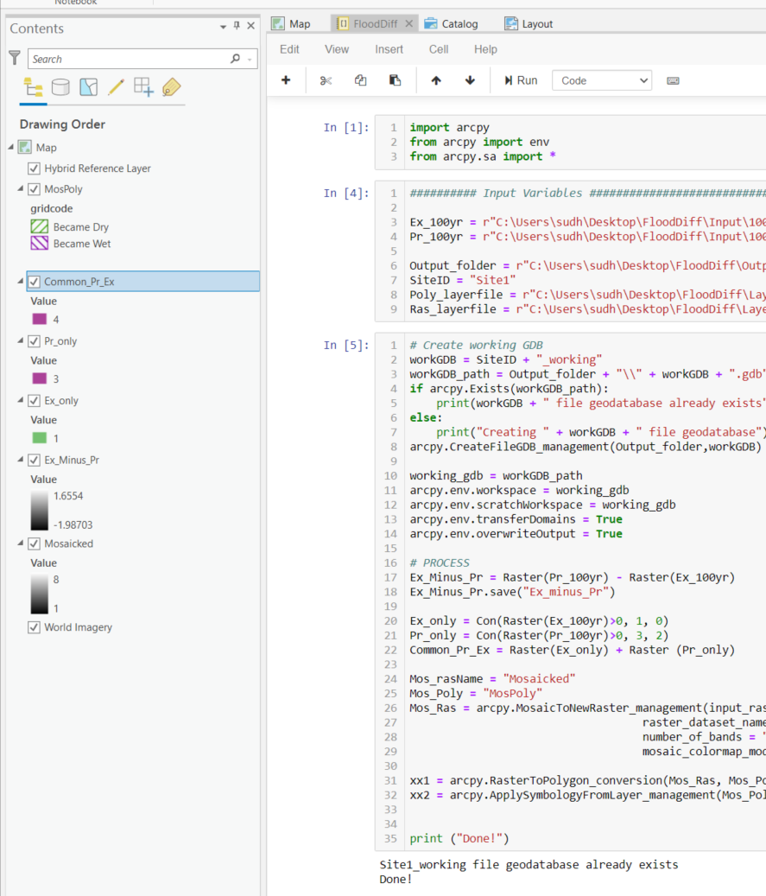
GIS workflow
Go to the third cell and press “Run”. This step will take a few moments. So, wait until the mouse pointer converts back from “working” to “ready-to-use”.
The output is a number of rasters and polygon on the map.

Slide 18
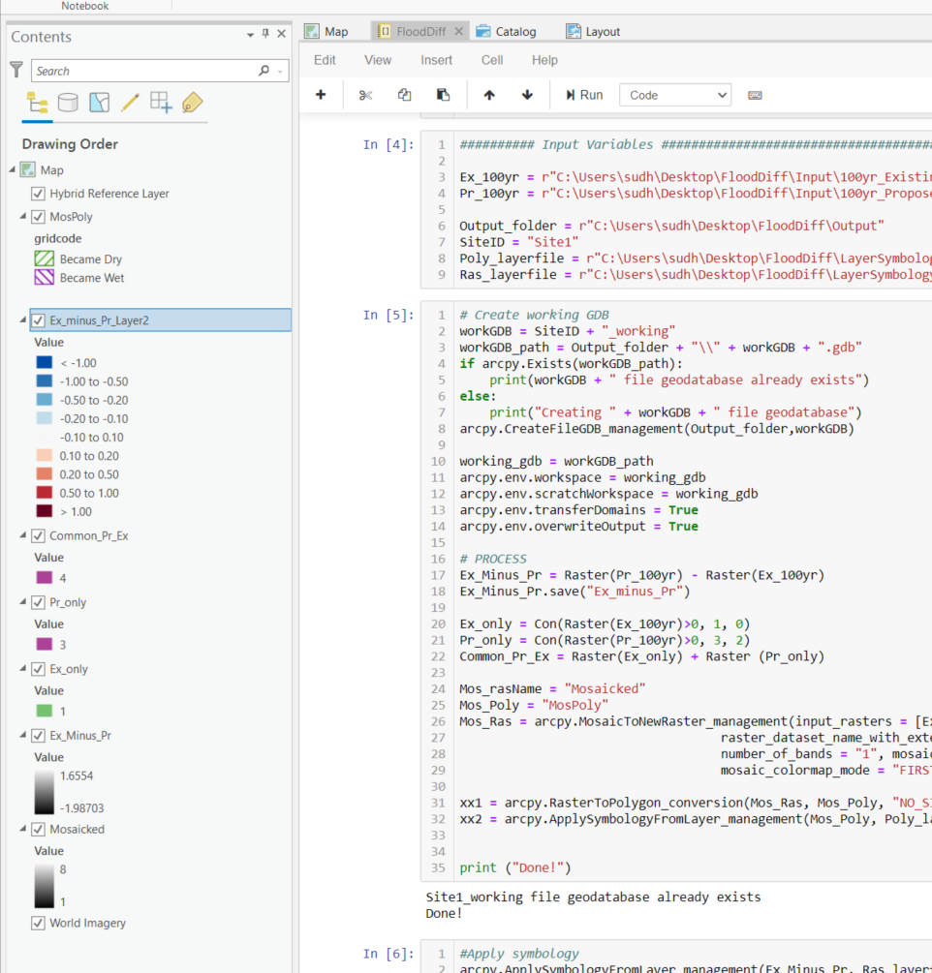
GIS workflow
Go to the 3rd cell and press Run.
A symbolized difference layer appears in the map.

Slide 19
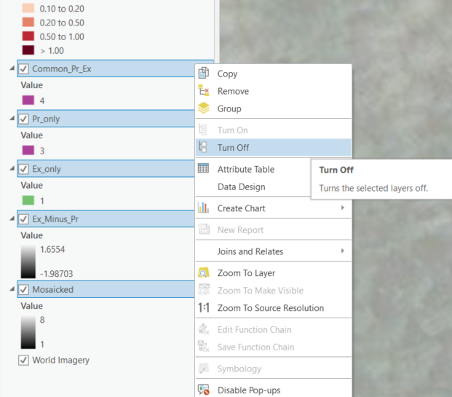
GIS workflow
Right click on all the layers other than MosPoly and Ex_minus_Pr_Layer2. Turn them off

Slide 20
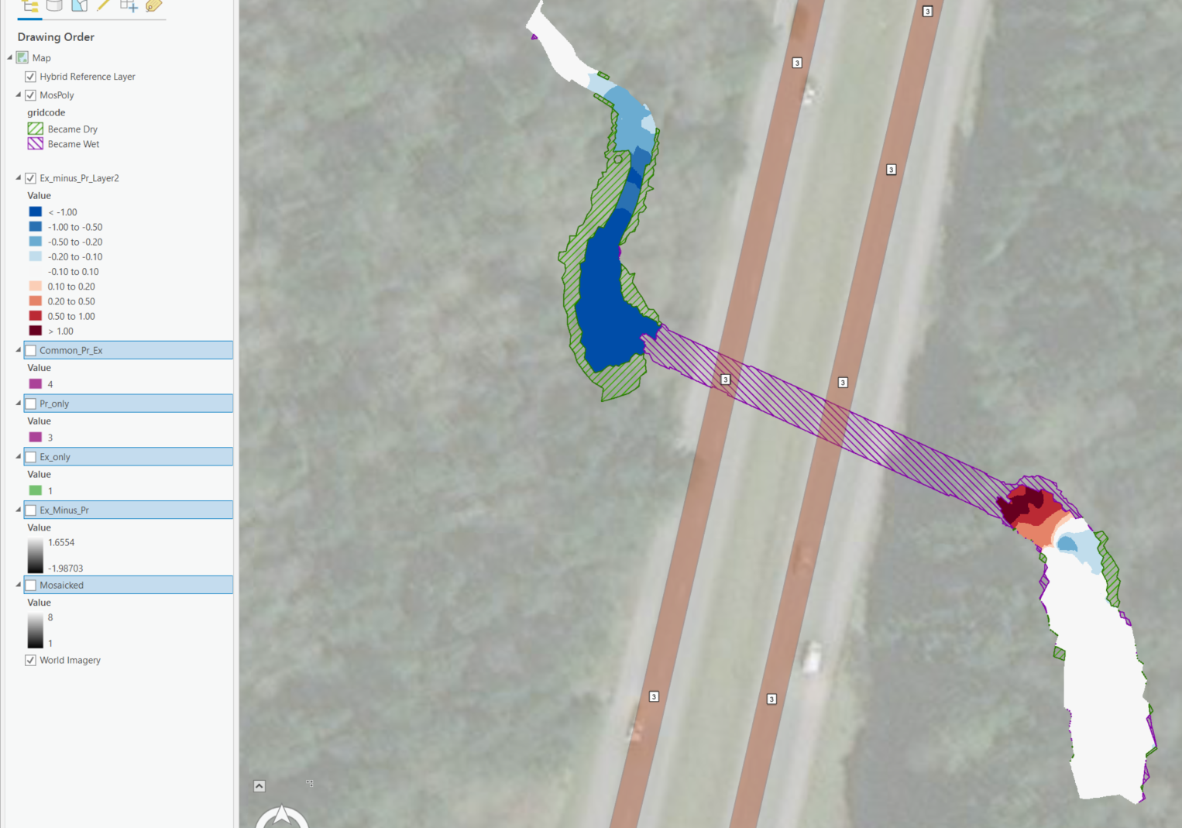
GIS workflow
You should be able to see only the necessary layers.

Slide 21
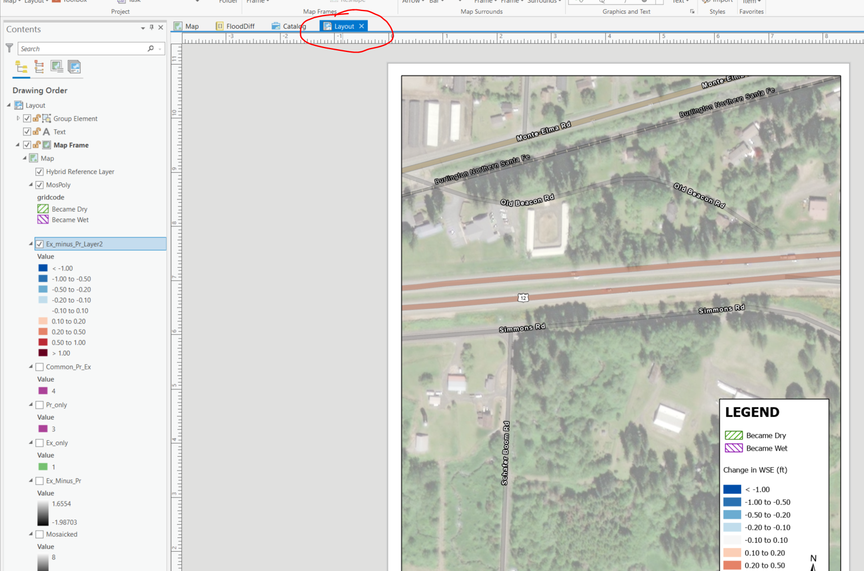
GIS workflow
Go to Layouts tab.

Slide 22
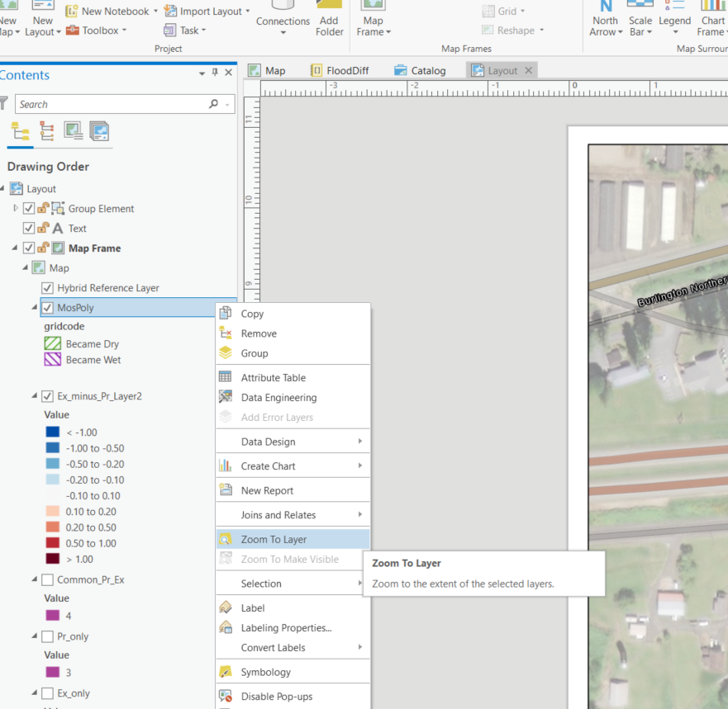
GIS workflow
Right click on the MosPoly Layer in table of contents and zoom to layer

Slide 23
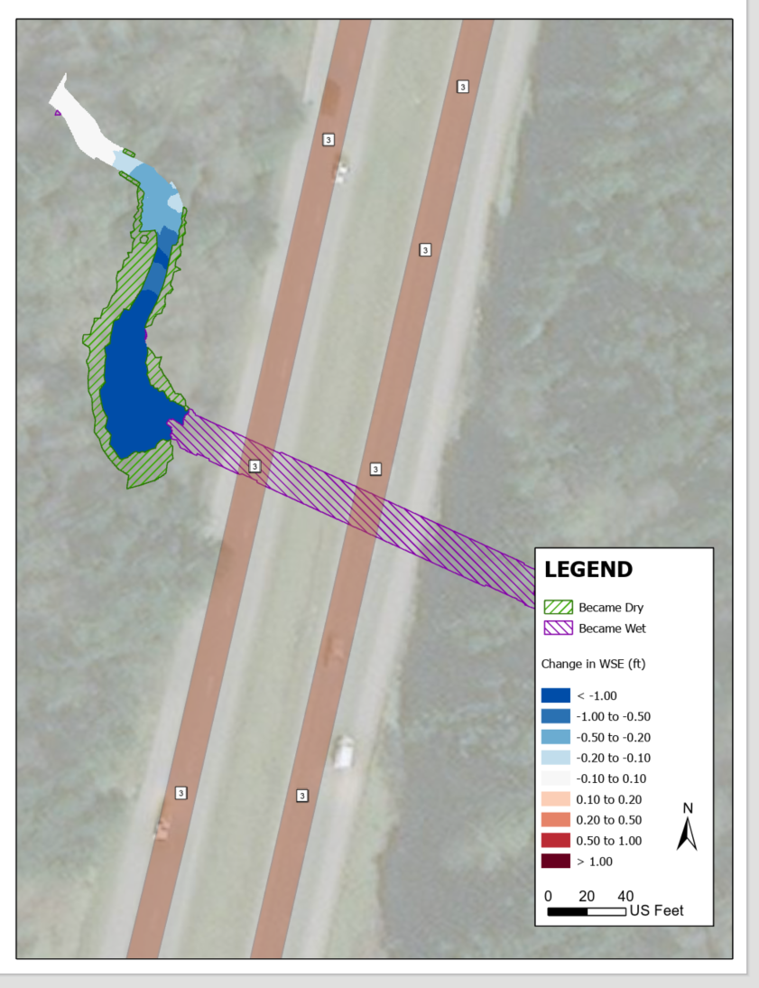
GIS workflow
The site should be within the viewport

Slide 24
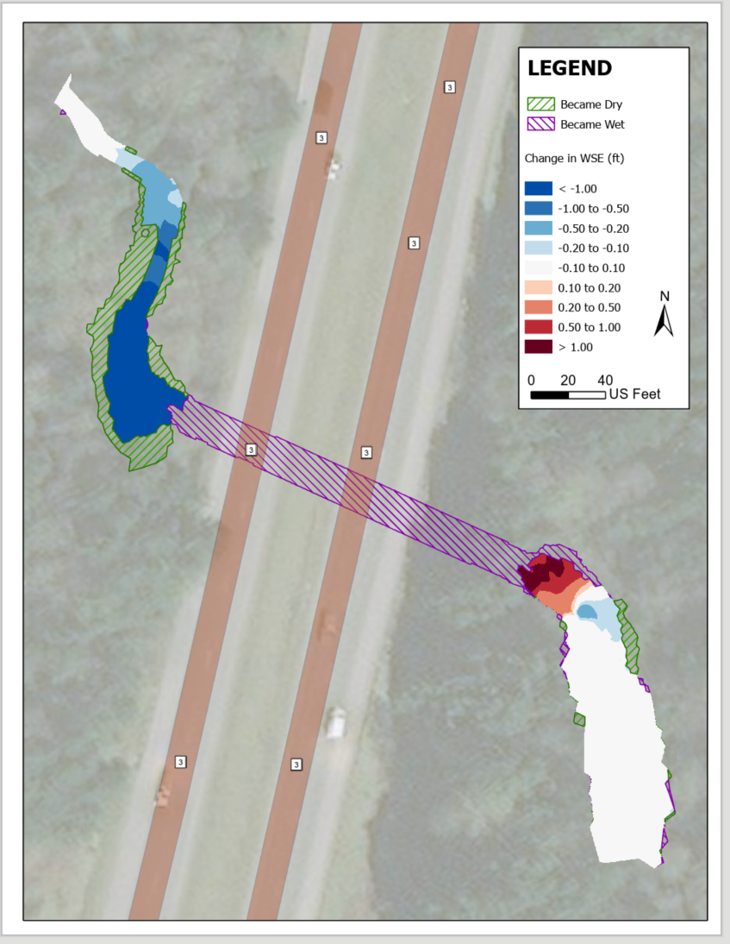
GIS workflow
Move the entire grouped legend area to where you want

Slide 25
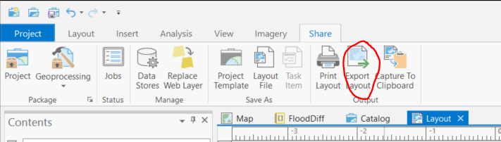
GIS workflow
In the ribbon, go to Share -> Export layout

Slide 26
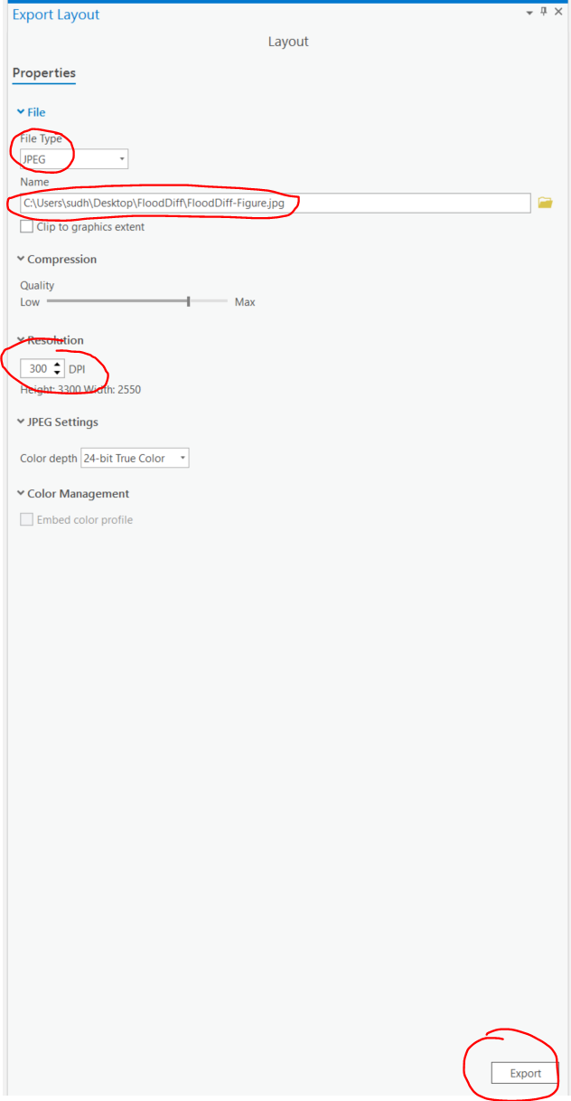
GIS workflow
In the ribbon, go to Share -> Export layout
Then export the image in the format you need.

